Slide 1
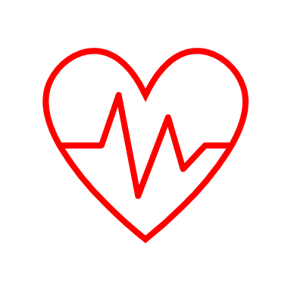
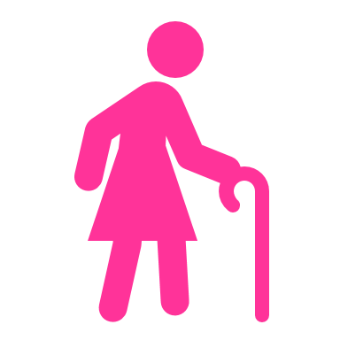
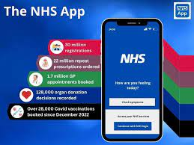
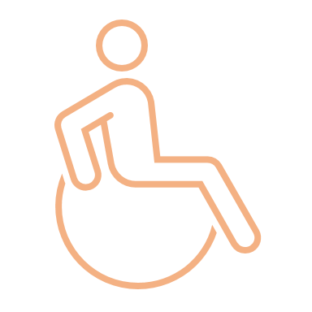
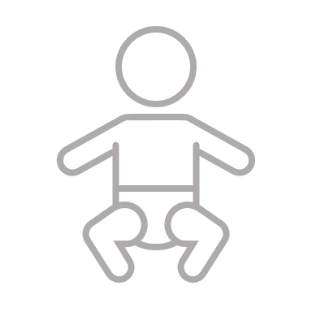
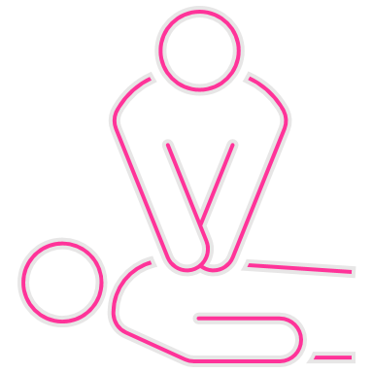
UX200 User Experience & Interface Design (UX/UI) Susan Young
December 2024
Brief One: Preparing for the Future
How has the NHS used User Experience Design and User Interface Design today?
User Experience and User Interface (UX and UI) what does it stand for?
User Experience (UX) and User Interface (UI) are different aspects of designing and developing digital products, for websites and mobile apps.
UX focuses on the experience and how the user interacts with the software to meet their needs, tap into their emotions, serve a purpose and create a straightforward enjoyable experience.
UI is focused on visual designs, layout and aesthetics and the way the user interacts with the product.
The National Health Service (NHS) in the United Kingdom is a publicly funded healthcare system that provides a wide range of healthcare services. So, a visit to the Doctor, Dentist, hospital, pharmacy the first “User Experience Design is the prominent NHS logo which is recognisable and important to everyone living in the UK. People may be unaware that the NHS is divided into many services with different funding streams, however, expectations are that all NHS organisations always provide high quality and standards.
User Interface Design
The NHS App was launched in December 2018 and was designed to provide a convenient way for patients to access healthcare services, including booking appointments, ordering repeat prescriptions and checking symptoms. The app is constantly being developed to be user friendly and accessible. Since its launch remains in beta as the unpredicted global pandemic meant the app had to be designed to support the fair process of COVID immunisations for the public and provide a COVID passport for travel after restrictions began to lift.
User Experience and User Interface (UX and UI) what does it stand for?
I work for the Northumbria Healthcare Trust within the NHS and the app is a one stop shop to NHS services, by providing support in one place and is accessible to everyone. I see that the accessible options are the first point of contact on the app, which can be easily collapsed if not applicable. My research into the user-centred design is not just about usability, at root the NHS will be addressing needs. Dyslexic users, for instance, can benefit from diagrams and images, but making diagrams and images integral to content can create a barrier for users of screen readers or with low vision.
I discovered an interesting fact that according to the Office of National Statistics (ONS) 96.7 percent of the population of the United Kingdom (UK) were using the internet in 2021, meaning the NHS app will provide a service to a high proportion of the public.
I know that Cyber Security – for the NHS is at constant risk of hacking with firewalls and security being constantly updated and the constant pressure to secure sensitive and personal data is challenging with the acceleration of AI technology. Unfortunately, Data breaches happen with social media in the public domain, extensive annual training is provided to staff to raise awareness and educate on how to prevent risks. We all have a responsibility for Data Protection and is a focus for the IT security team. As a staff member of the learning & development team, I use smartcard to access staff training records and don't have access to any systems that aren't relevant to my role. There are different levels of security for access, and we are in the transition process to move onto another learning management system (LMS) as the current system is no longer fit for purpose and cannot cope with the demands of modern technology. The existing system is ESR 'the dinosaur 'which struggles to cope with the heavy demands from over 11,000 staff members trying to access the system to complete statutory and mandatory e-Learning. This means that at times, ESR struggles to update e-Learning as complete, and we cannot update training records without an audit trail of screenshots to confirm assessments are complete. The replacement LMS system Kallidus means we are transferring staff in batches of business units, Kallidus has had teething problems, however, is modern platform and a better learning experience for staff and easier for me to manage and upload content as e-Learning Facilitor for the Trust.
In my research for the NHS design ,Matthew Gould, NHS Chief Executive, put it, we “create the right platform and let others innovate on it”. The app is constantly evolving as it incorporates additional services, and they build upon what they have, identifying gaps and presumptions, their log in process took two years of research and testing.
I use the NHS App personally to order prescriptions, check symptoms, allergies, arrange COVID & Flu injections and have noticed many improvements since its launch, it’s easier to find which service you require. I use facial recognition to open the APP and feel confident using the services provided, there is a vast improvement to the speed moving between services, it's much quicker with no lagging.
I find it interesting that during 23/24 they are working through the Health Education England, NHS Digital and NHS England merger a single organisation, this new NHS England will be more responsive to the biggest challenges and opportunities of the system. It is now the single non-departmental government body responsible for digital technology, data and health service delivery in the NHS. The merger is working in more efficient ways to improving diagnosis and treatment, understanding and improving services, which I feel will provide a cost-effective robust solution by sharing resources, rather than working in silos, combined knowledge and experience will create a stronger and updated digital experience for the public and health services.

Slide 2
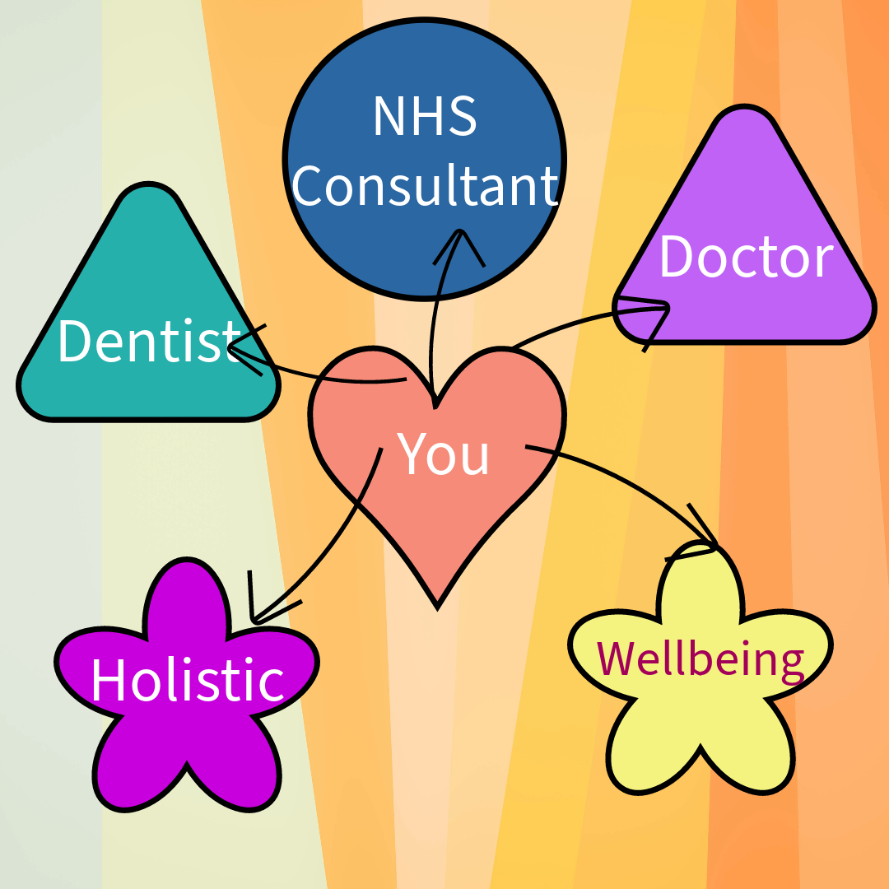
I am proud to work for the Northumbria Healthcare Trust NHS and I understand that fast paced technology can cause stress for the public and staff face similar challenges. For example, since the pandemic, there is an expectation that our nurses deliver high quality care whilst being technology experts. For data security, it's imperative that all patient care is electronically recorded. We use many IT systems, with the added difficulty that not all systems can communicate with each other, and with new software being introduced to improve patient experience and the recording and monitoring of data to keep information safe and relevant; brings additional challenges which can impact staff confidence. IT Training is offered to staff; however, time constraints are challenging with demands on nursing and arranging time to develop technology skills, which may not be a quick fix and may take time for skill development and confidence. So having inside knowledge, I know there isn't an easy fix or quick solution to an ever increasing health service.
My thoughts about redesigning the NHS APP are to have the launch screen, with colourful shapes to help easily identify which area of support is required and then behind the click to have clear direction of the next steps, which is easy to use and functional.
I drafted the launch screen using Adobe Illustrate and enjoyed exploring colours, fonts and different shapes. I felt it important to have "You" as the central main focus with different colourful options to select. I like how the design looks and feels and if I had time, would have designed what each of the services would look like behind each of the shape options.
I'm building confidence using Adobe Illustrate and getting to know how the features work and introducing the software now into my work projects.
Summary

