Slide 1
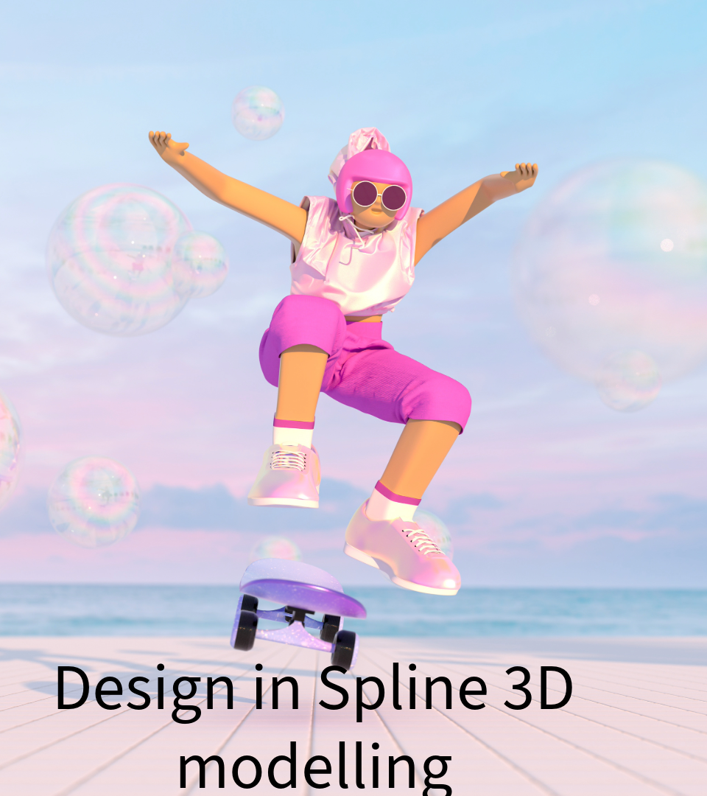

Slide 2
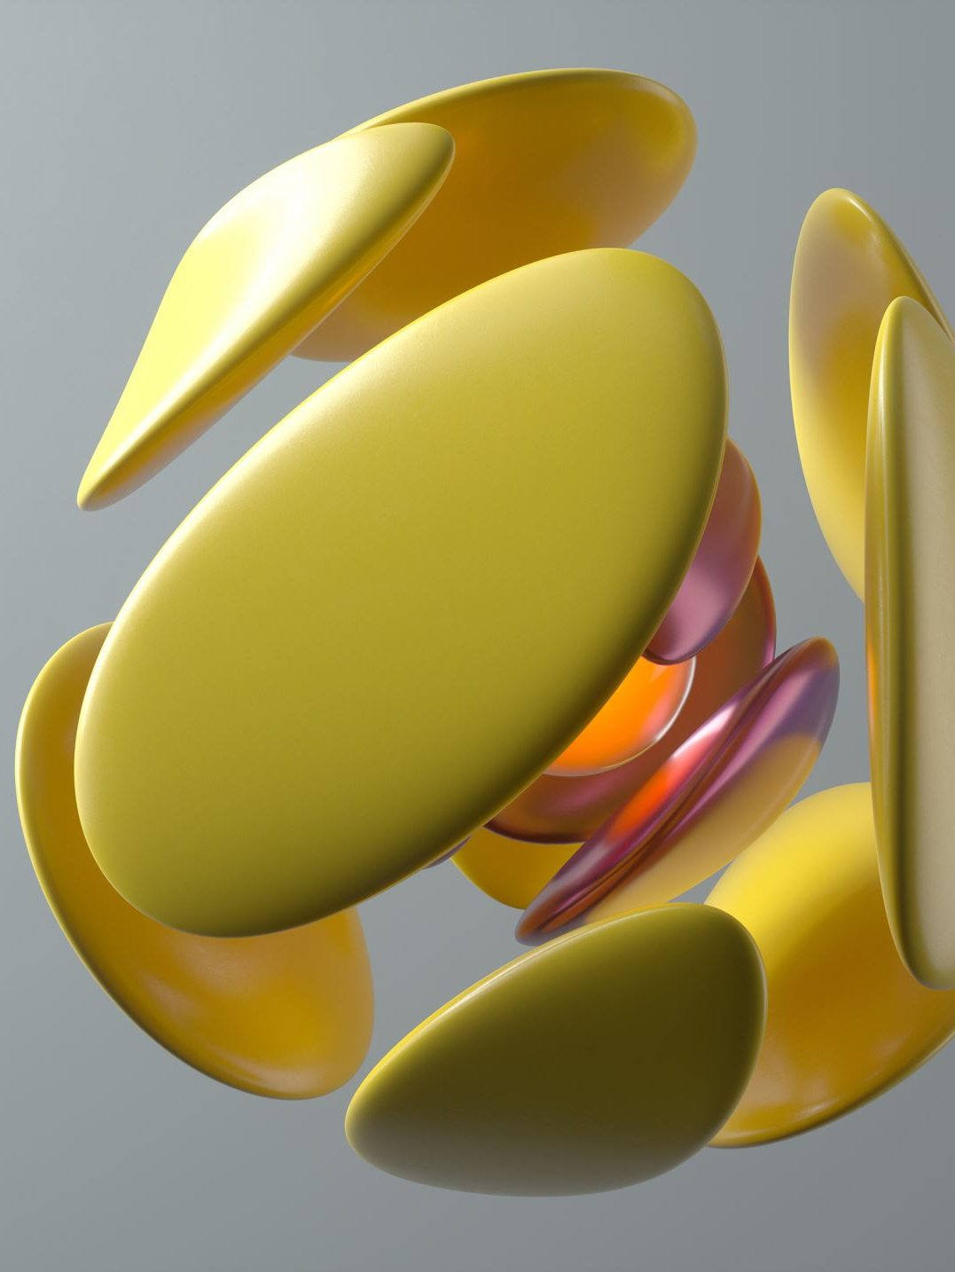
I've used Spline a little and wanted to explore 3D shapes.
I have captured in the following video, my design, with added particles and animation. I enjoy using Spline and would consider using at work for e-Learning, for example, I could use Spline for 3D medicine and use the follow me option for staff to explore the journey of medicine from production to patient.

