Slide 1
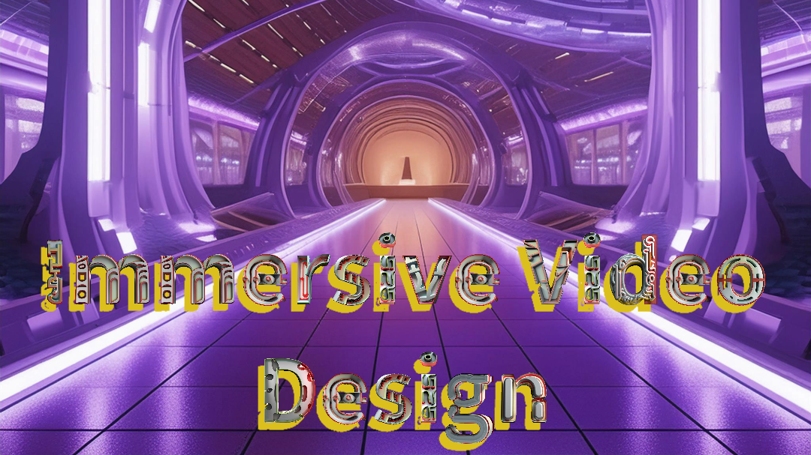

Slide 2
An introduction to Immersive Video Design using Novak designers as influence, was so impressive on a magnificent scale and quality images.
I loved seeing the results of Novak https://novak.uk/about/
There wasn't enough time or access to the right software to start building skills with this type of design.
Reality is there is a lack of time and unlimited cash to fund an extensive range of software to explore further.

