Slide 1
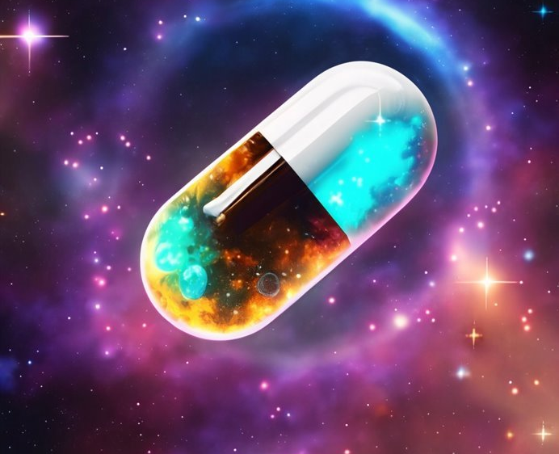
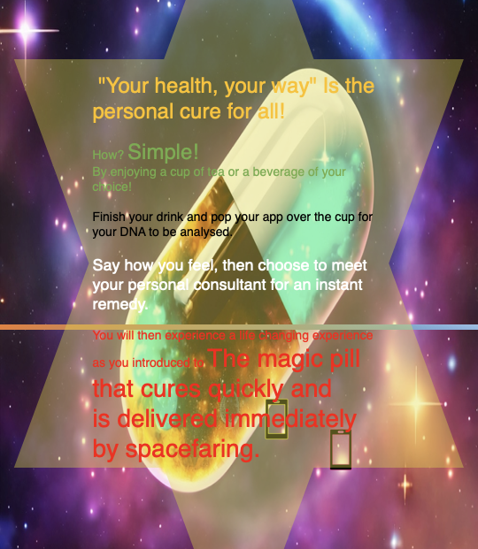
My design for the future idea is a magic pill that will cure everything.
After a drink, you use the app to analyse your DNA from the cup or glass, which will immediately confirm if you're healthy or need to see your personal consultant straightaway.
Sales Pitch
"Your health, your way" Is the personal cure for all! How? Simple! By enjoying a cup of tea or a beverage of your choice! Finish your drink and pop your app over the cup for your DNA to be analysed. Say how you feel, then choose to meet your personal consultant for an instant remedy. You will then experience a life changing experience as you're introduced to The magic pill that cures quickly and is delivered immediately by spacefaring.

Slide 2
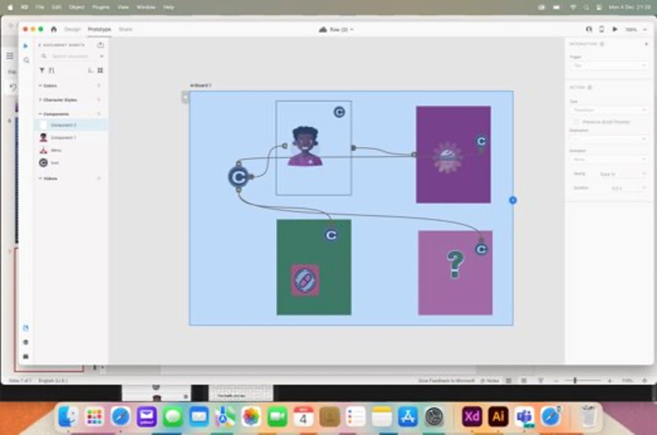
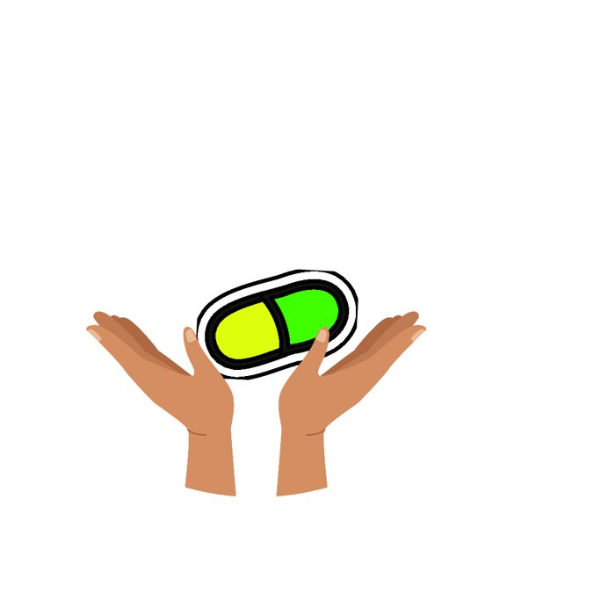
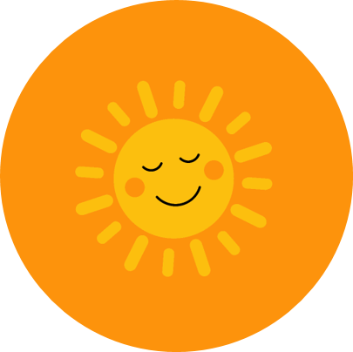
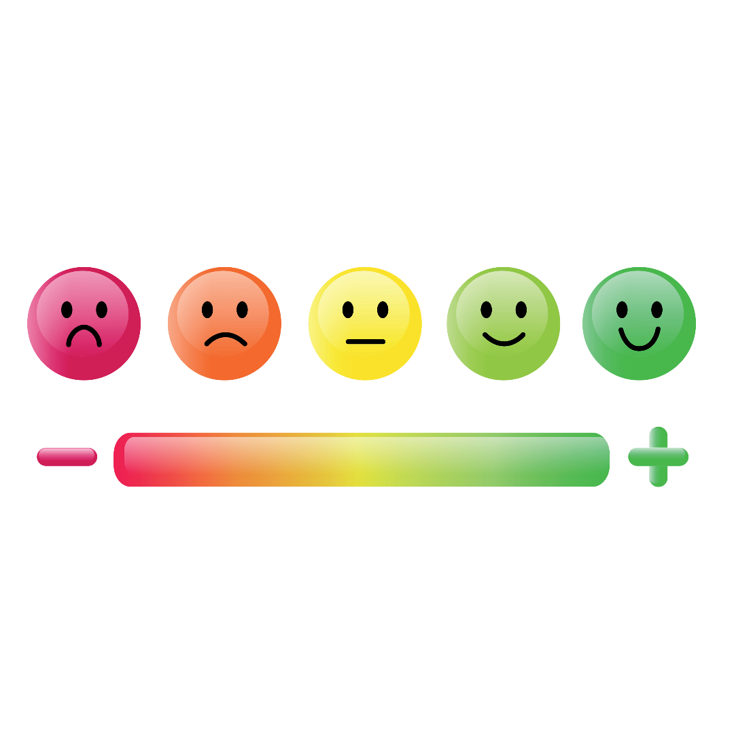
App design ​
I tried different options and designs to achieve a sample. I'm happy that I connected the components to make the app work. When reflecting on the design, the images are cartoonlike, I would improve the Images to match the futuristic design of the magic pill design. ​
​
​
Here is the wireframe
First prototype design of The App using Adobe XD
https://xd.adobe.com/view/8d52265a-45f9-4c00-8d62-7fae96c5269f-d801/
Here are a selection of images I designed using Adobe illustrate for the app

Slide 3
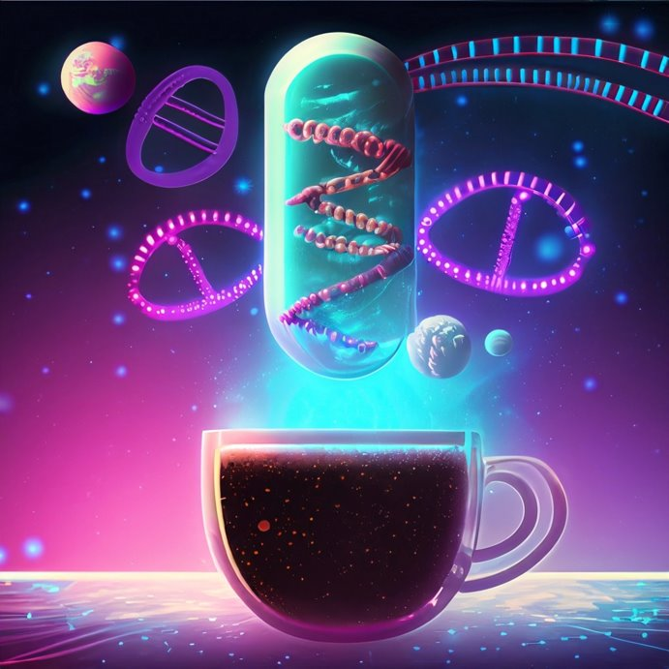
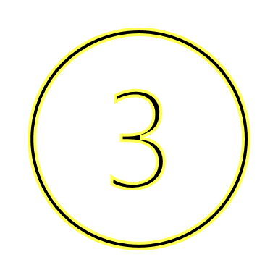

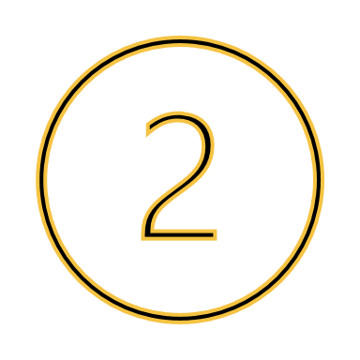
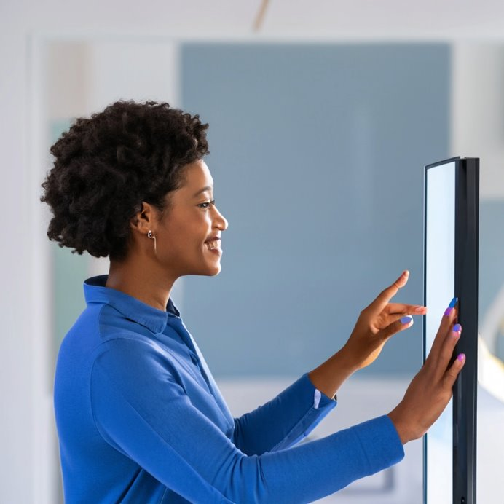
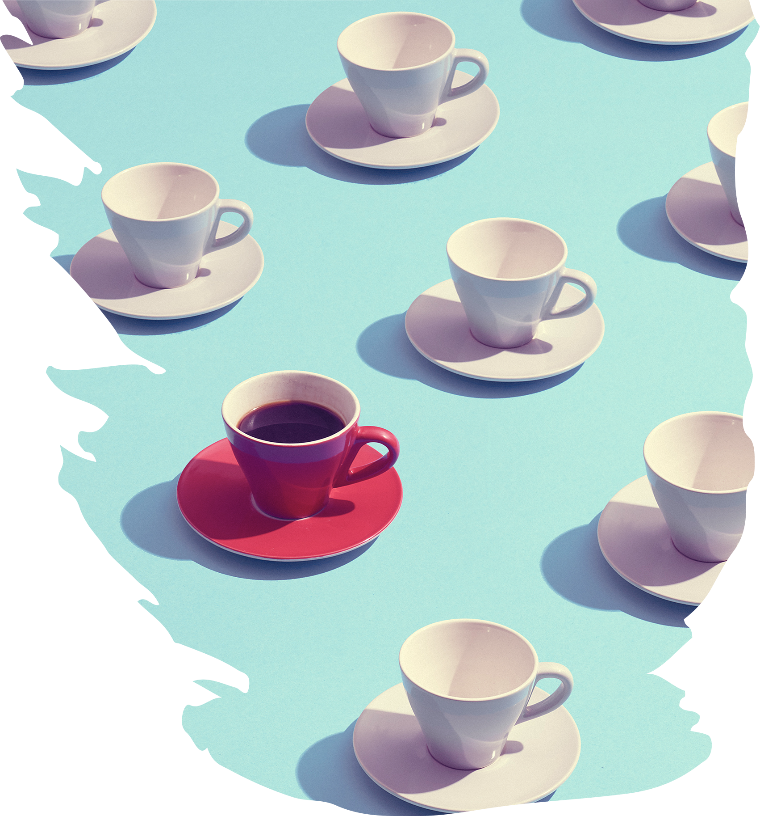
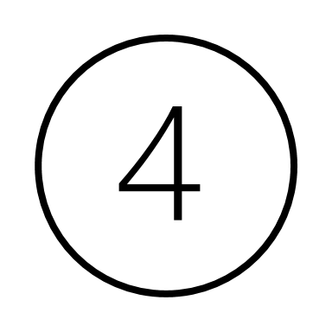
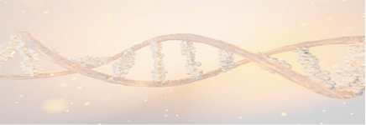
Cup of tea/magic pill and DNA designs. Here I played around with different ideas of how the magic pill would work. My first idea was to have a touchscreen mirror, but then chatting through my design ideas with a friend who is a senior clinical NHS employee, we produced the eureka moment of the DNA transfer from drinking a cup of tea or beverage of your choice. Image 2 is an example of exploring ideas using Adobe Illustrate. Image 3 Is generated from the AI function on illustrate and searched, "magic pill, DNA & cup of tea. I preferred this image and enjoyed experimenting with AI technology and discovering the types of images produced. Image 4 is a DNA video I searched for and decided against using because although I liked the video, I felt it wouldn't work in the demo.

Slide 4

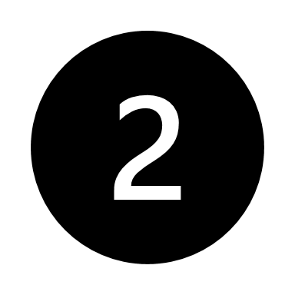
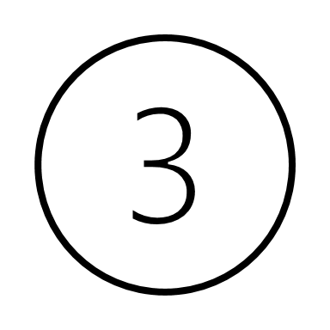
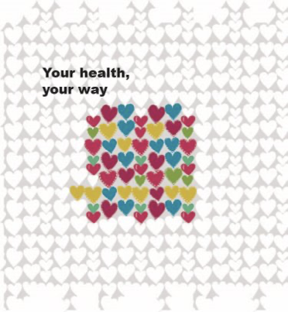
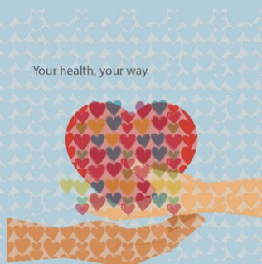
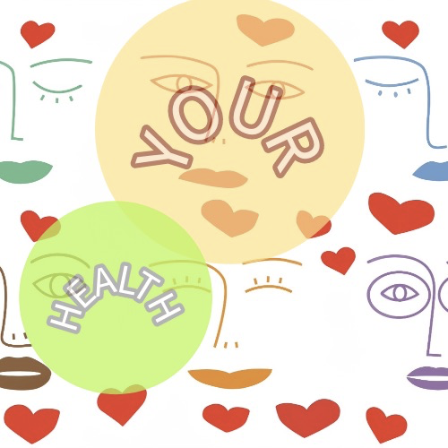
I designed 3 different logos with a heart, my thoughts were to keep to the theme of Your health, your way as the focus.
Logo 3 was my first design, which I do like and will use this idea in future logos.
Logo 1 was my second design, I like the background hearts that look like lace, the image began has a heart and then became abstract the more I explored colours. I used design 2 for the app design as I liked the heart being held in hands with lace hearts from design 1, which I experimented with contrasts. If I had time to design the logo to improve the look, I would make the text prominent and fade the hands more into the background of the design. I enjoyed playing around with colours, fonts and design

